Slide 1

CMP302: Algorithms
Lecture 01: Introduction
Mayada Mansour Hadhoud
Computer Engineering Department
Cairo University
Fall 2014

Slide 2
Acknowledgement
To Dr Magda Fayek, Dr Rabie and Dr Mohammed Aly

Slide 3
Introduction
An algorithm is:
A sequence of unambiguous instructions for solving a problem.
A computational procedure that takes some values as input and produces some values as output.
A procedure for getting answers to a specific problem
A problem solving strategy even if computers are not involved
problem
algorithm
input
“computer”
output

Slide 4
Why we study algorithms?

Slide 5
Algorithm design strategies
Brute force
Divide and conquer
Decrease and conquer
Transform and conquer
Greedy approach
Dynamic programming

Slide 6
The problem of sorting
Input: sequence 〈a1, a2, …, an〉 of numbers.
Output: permutation 〈a'1, a'2, …, a'n〉 such that a'1 ≤ a'2 ≤ … ≤ a'n.
Example:
Input: 8 2 4 9 3 6
Output: 2 3 4 6 8 9

Slide 7
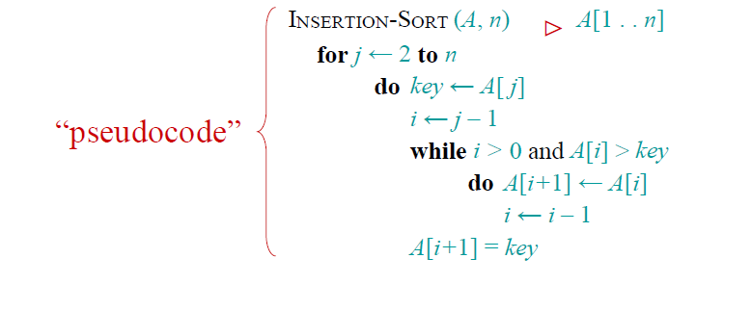
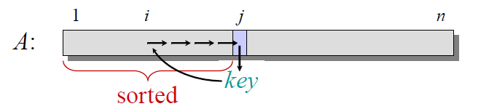
The problem of sorting

Slide 8


Example of insertion sort

Slide 9

Example of insertion sort

Slide 10
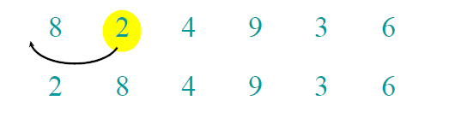
Example of insertion sort

Slide 11
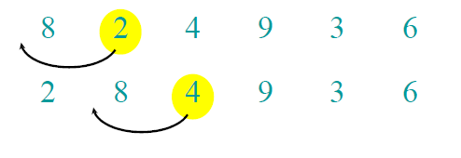
Example of insertion sort

Slide 12
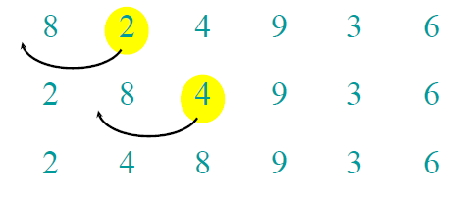
Example of insertion sort

Slide 13
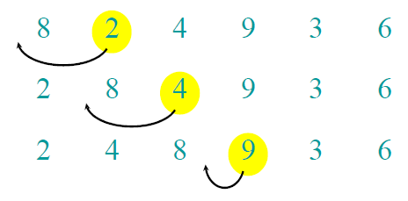
Example of insertion sort

Slide 14
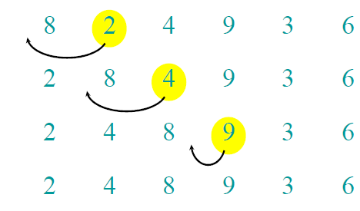
Example of insertion sort

Slide 15
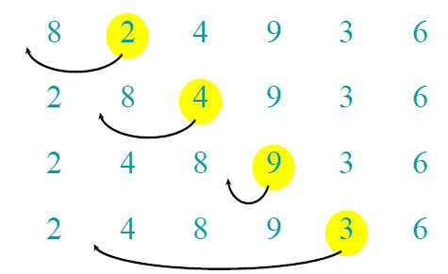
Example of insertion sort

Slide 16
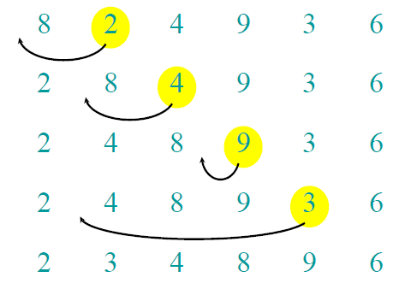
Example of insertion sort

Slide 17
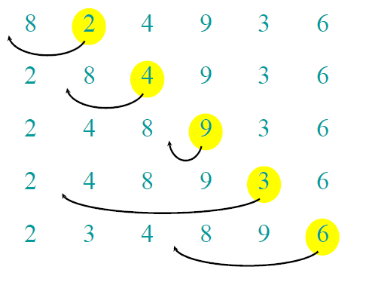
Example of insertion sort

Slide 18
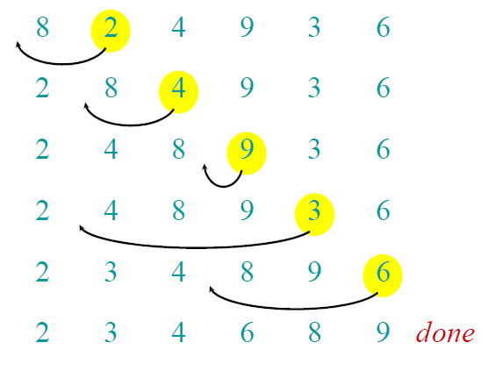
Example of insertion sort

Slide 19
Analysis of Algorithms
How good is the algorithm?
Correctness
Time efficiency
Space efficiency

Slide 20
Analysis of Algorithms
Space analysis
When considering space complexity, algorithms are divided into those that need extra space to do their work and those that work in place.
Space analysis would examine all of the data being stored to see if there were more efficient ways to store it.

Slide 21
Analysis of Algorithms
Time efficiency is analyzed by determining the number of repetitions of the basic operation as a function of input size
Basic operation: the operation that contributes the most towards the running time of the algorithm
T(n) ≈ c_{op}C(n)
input size
running time
execution time
for basic operation
or cost
Number of times basic operation is executed

Slide 22
Input size and basic operation examples
Problem | Input size measure | Basic operation
Searching for key in a list of n items | Number of list’s items, i.e. n | Key comparison
Multiplication of two matrices | Matrix dimensions or total number of elements | Multiplication of two numbers
Typical graph problem | #vertices and/or edges | Visiting a vertex or traversing an edge
Notes:
Check if a number is prime or not :
- In practice, one often wants to check whether a given number is prime, rather than generate a list of primes as the two mentioned sieve algorithms do.
- The most basic method to do this, known as trial division, works as follows: given a number n, one divides n by all numbers m less than or equal to the square root of that number. If any of the divisions come out as an integer, then the original number is not a prime. Otherwise, it is a prime.

Slide 23
Importance of analysis
It gives an idea about how fast the algorithm
If the number of basic operations
C(n) = ½ n (n-1) = ½ n² – ½ n ≈ ½ n²
How much longer if the algorithm doubles its input size?
Increasing input size increases the complexity
We tend to omit the constants because they have no effect with large inputs
Everything is based on estimation
T(n) ≈ c_{op}C(n)

Slide 24
Importance of analysis
Assume:
Algorithm X takes time 2n² (written by best programmer) running on machine with 1000 MIPS
Algorithm Y takes time 50n lg n (written by worst programmer) running on machine with 10 MIPS
Running time for 10⁶ numbers
Algorithm X takes 2000 seconds
Algorithm Y takes ~100 seconds
Complexity makes a huge difference!

Slide 25
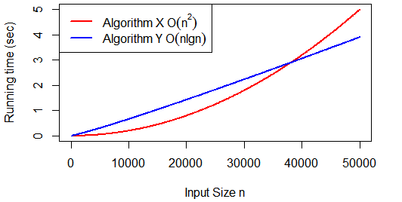
Importance of analysis
Assume:
Algorithm X takes time 2n² (written by best programmer) running on machine with 1000 MIPS
Algorithm Y takes time 50n lg n (written by worst programmer) running on machine with 10 MIPS

Slide 26
Kinds of analysis
For some algorithms, efficiency depends on form of input:
Worst case: C_{worst}(n) – maximum time of algorithm over inputs of size n
Best case: C_{best}(n) – minimum time of algorithm over inputs of size n
Average case: C_{avg}(n) – “average” over inputs of size n
Determine the number of different groups into which all possible input sets can be divided.
Determine the probability that the input will come from each of these groups.
Determine how long the algorithm will run for each of these groups.

Slide 27
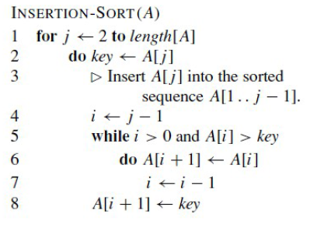


Insertion sort analysis
Basic operation: comparison A[i]>key
# of comparisons =

Slide 28
Insertion sort analysis
Space Analysis: inplace

Slide 29
Order of growth
Of greater concern is the rate of increase in operations for an algorithm to solve a problem as the size of the problem increases.
This is referred to as the rate of growth of the algorithm.
Notes:
Example: cn²
how much faster on twice as fast computer? (2)
how much longer for 2n? (4)

Slide 30
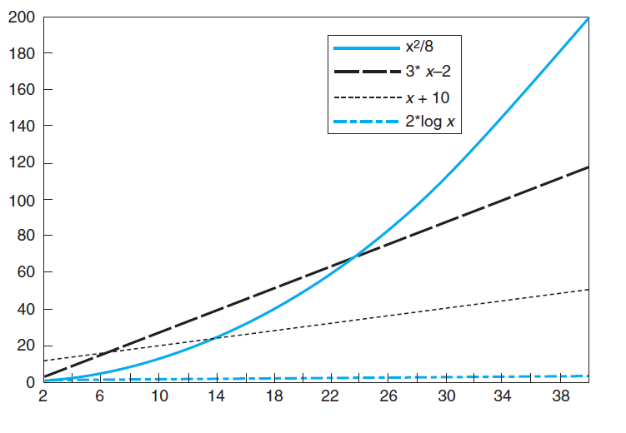
Order of growth
The function based on x² increases slowly at first, but as the problem size gets larger, it begins to grow at a rapid rate.
The functions that are based on x both grow at a steady rate for the entire length of the graph.
The function based on log x seems to not grow at all, but this is because it is actually growing at a very slow rate.
Notes:
Example: cn²
how much faster on twice as fast computer? (2)
how much longer for 2n? (4)

Slide 31
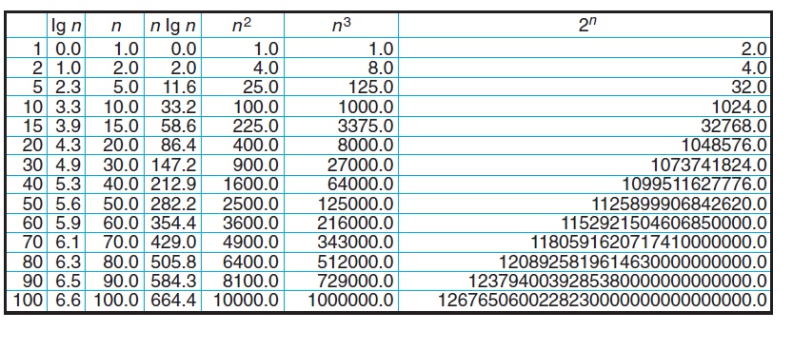
Values of some important functions as n → ∞

Slide 32

Order of growth
Second point to consider :
Because the faster growing functions increase at such a significant rate, they quickly dominate the slower-growing functions.
This means that if we determine that an algorithm’s complexity is a combination of two of these classes, we will frequently ignore all but the fastest growing of these terms.
Example : if the complexity is
we tend to ignore 30x term
Notes:
Example: cn²
how much faster on twice as fast computer? (2)
how much longer for 2n? (4)

Slide 33
Classification of Growth Asymptotic order of growth
A way of comparing functions that ignores constant factors and small input sizes.
O(g(n)): class of functions f(n) that grow no faster than g(n)
All functions with smaller or the same order of growth as g(n)
Ω(g(n)): class of functions f(n) that grow at least as fast as g(n)
All functions that are larger or have the same order of growth as g(n)
Θ(g(n)): class of functions f(n) that grow at same rate as g(n)
Set of functions that have the same order of growth as g(n)

Slide 34
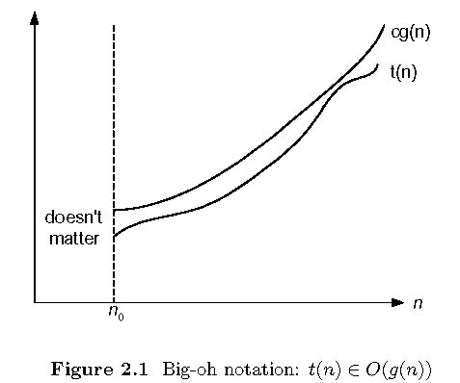
Big-oh
O(g(n)): class of functions t(n) that grow no faster than g(n)
if there exist some positive constant c and some nonnegative n0 such that

Slide 35
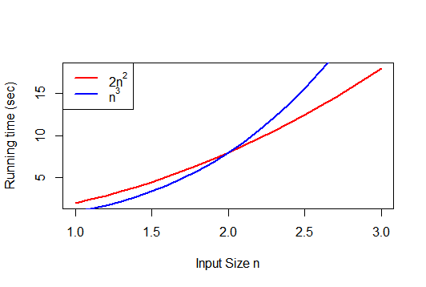

Slide 36
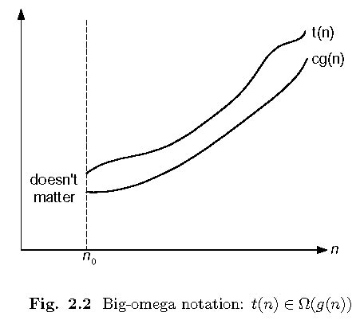
Big-omega
Ω(g(n)): class of functions t(n) that grow at least as fast as g(n)

Slide 37
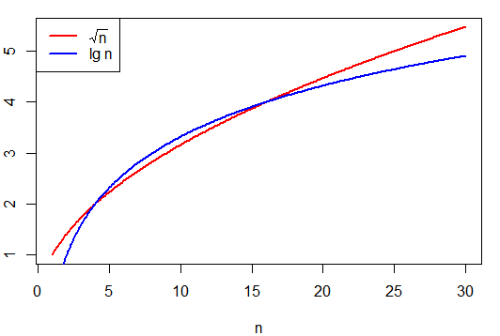

Slide 38
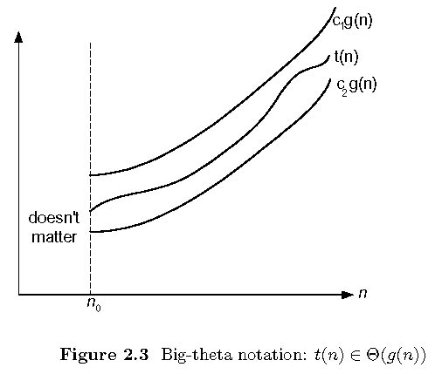
Big-theta
Θ(g(n)): class of functions t(n) that grow at same rate as g(n)

Slide 39
Summary
>=
Ω(g(n)), functions that grow at least as fast as g(n)
=
Θ(g(n)), functions that grow at the same rate as g(n)
g(n)
<=
O(g(n)), functions that grow no faster than g(n)

Slide 40
Orders of growth of some important functions
All logarithmic functions log_{a} n belong to the same class Θ(log n) no matter what the logarithm’s base a > 1 is because
All polynomials of the same degree k belong to the same class:
a_{k}n^{k} + a_{k-1}n^{k-1} + … + a₀ ∈ Θ(n^{k})
Exponential functions a^{n} have different orders of growth for different a’s

Slide 41
Basic asymptotic efficiency classes
1 | constant
log n | logarithmic
n | linear
n log n | n-log-n
n² | quadratic
n³ | cubic
2^{n} | exponential
n! | factorial

